Slide 1

THE VRUKKSHA SCHOOL
(AFFILATED TO CBESE - 831321)
STUDENT : MAHITH and sameer
CLASS : IX
TOPIC : Euclidean Geometry
SUBJECT : MATHS

Slide 2
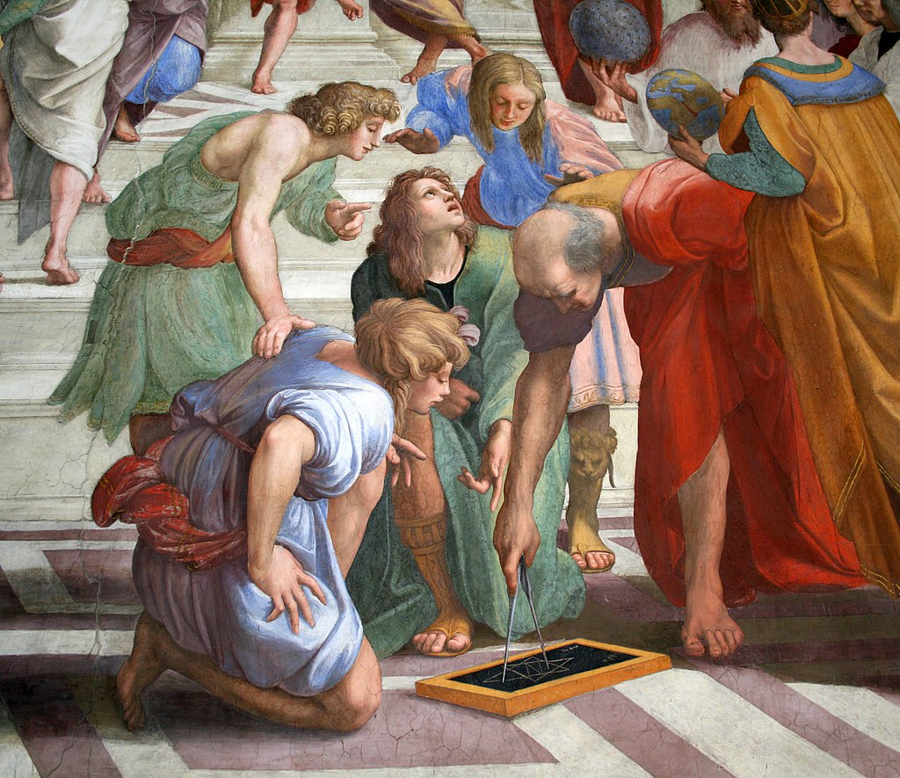
an Introduction to Euclidean Geometry
Euclidean geometry is a fundamental branch of mathematics that studies points, lines, angles, shapes, and their properties.
It is based on a set of axioms and postulates, which serve as the foundation for all geometric proofs and construction.

Slide 3
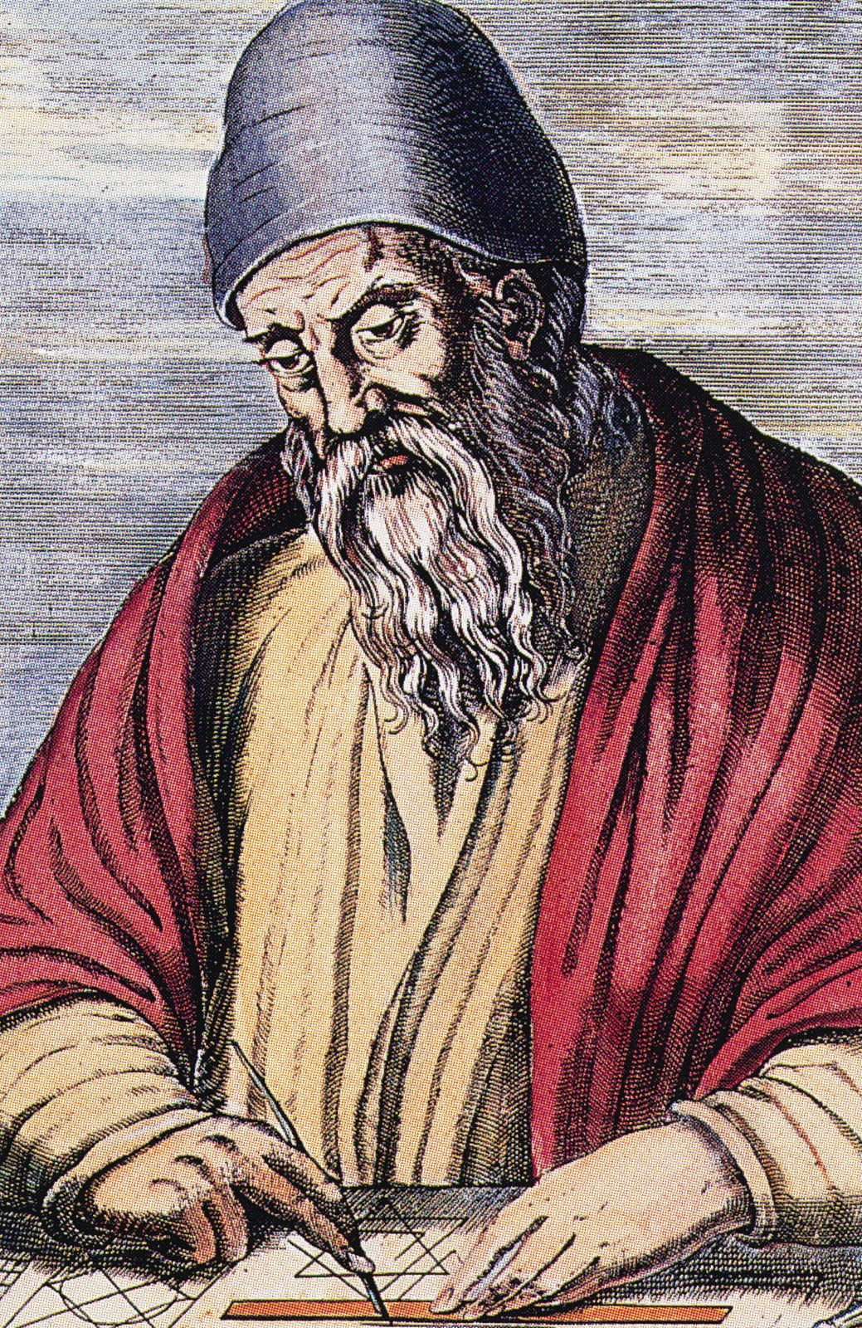
Who discovered Euclidean Geometry
Euclid, often called the father of geometry.
He changed the way we learn about shapes with his 13-book series, Euclid's Elements.
He used basic ideas called axioms or postulates to create solid proofs and figure out new ideas called theorems and propositions.

Slide 4

Definitions and Fundamental Concepts
Point
A basic geometric object without dimensions.
Line
A straight path that extends infinitely in both directions.
Plane
A flat surface that extends infinitely in all directions.
Angle
The space between two intersecting lines or rays.

Slide 5
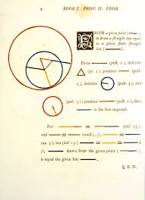
WHAT ARE AXIOMS AND POSTULLATES
AXIOM:
An axiom is a statement that is generally accepted to be true without proof.
POSTULLATES:
The basic facts which are taken, for granted, without proof and which are specific to geometry

Slide 6
axioms
Things which are equal to the same thing are also equal to one another.
If equals be added to equals, the wholes are equal.
If equals be subtracted from equals, the remainders are equal.
Things which coincide with one another are equal to one another.
The whole is greater than the part.
Things which are double of the same things are equal to one another.
Things which are halves of the same things are equal to one another.

Slide 7
POSTULLATES
Postulate 1 : A straight line may be drawn from any one point to any other.
Postulate 2 : A terminated line (a line segment) can be produced indefinitely.
Postulate 3 : A circle can be drawn with any center and any radius
Postulate 4 : All right angles are equal to one another.
Postulate 5: If two lines are intersected by a third in such a way that the sum of the inner angles on one side is less than two right angles, then the two lines will intersect each other on that side if produced indefinitely.

Slide 8
Applications of Euclidean Geometry
Architecture : Euclidean geometry is fundamental in architecture, where it is used to design structures, calculate dimensions, and ensure stability.
Engineering : Euclidean geometry is essential in engineering, where it is used to design bridges, roads, and other infrastructure.
Art : Euclidean geometry is found in various forms of art, from abstract paintings to sculptures and designs.

Slide 9
FEW QUESTIONS ON the TOPIC we just came across.
  What is an axiom?
  Who is often called the father of geometry?
  Which postulate is it : All right angles are equal to one another?
  How is Euclidean Geometry used in our life ?
  Euclidean Geometry is a fundamental branch of mathematics that studies on________

Slide 10


